Slide 1

Bank CRM Analysis

Slide 2
Table of Contents
Introduction
Problem Statement
Data Description
Objective & Subjective Insights
Dashboard
Conclusion

Slide 3
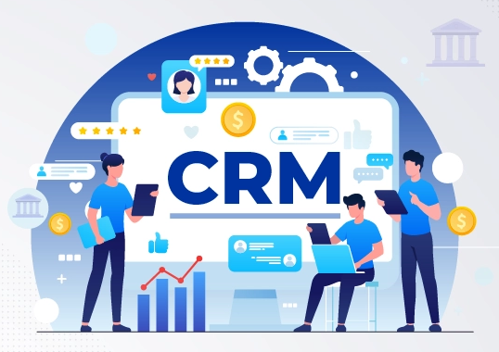
INTRODUCTION
Developing an Analytical CRM for a bank involves creating sophisticated tools to enhance decision-making through customer data analysis. This specialized system enables banks to gain deeper insights into their customers, identify trends, and make data-driven decisions. By leveraging analytics, banks can segment customers, observe behaviors, predict future actions, and monitor changes effectively.
The goal is to increase customer satisfaction and retention by tailoring offers and campaigns based on data insights. Analytical CRM is crucial for understanding customer behavior, optimizing bank operations, and fostering strong, enduring customer relationships.

Slide 4

PROBLEM STATEMENT
Customer churn, or the rate at which customers discontinue using our bank's services, significantly impacts our revenue and profitability. In this presentation, we will examine our bank's customer churn rates, focusing on factors such as gender, recent trends, credit card ownership, the number of products used, credit scores, and the regions from which customers are departing. Our objective is to identify the reasons behind customer attrition and propose strategies to enhance customer satisfaction and retention.

Slide 5
Data Description
Customer Id: A unique identifier for each customer.
Credit Score: A numerical representation of the customer's creditworthiness.
Credit score:
Excellent: 800–850
Very Good: 740–799
Good: 670–580
Poor: 300–579
Geography ID: A numerical identifier that likely corresponds to a geographical location, such as a country or region.
Gender ID: A numerical identifier for the customer's gender, where for example, '1' could represent male and '2' could represent female.
Age: The age of the customer.
Tenure: The number of years the customer has been with the bank.
Balance: Current balance in the customer's account.

Slide 6
Num Of Products: refers to the number of products that a customer has purchased through the bank.
Has Cr Card: denotes whether or not a customer has a credit card. This column is also relevant, since people with a credit card are less likely to leave the bank.
1 represents credit card holder
0 represents non credit card holder
Is Active Member: active customers are less likely to leave the bank (as per the criteria defined by the bank for identifying the activeness).
1 represents Active Member
0 represents Inactive Member
Estimated Salary: as with balance, people with lower salaries are more likely to leave the bank compared to those with higher salaries.
Exited: whether or not the customer left the bank.
0 represents Retain
1 represents Exit
Bank DOJ: date when the Customer associated/joined with the bank.

Slide 7
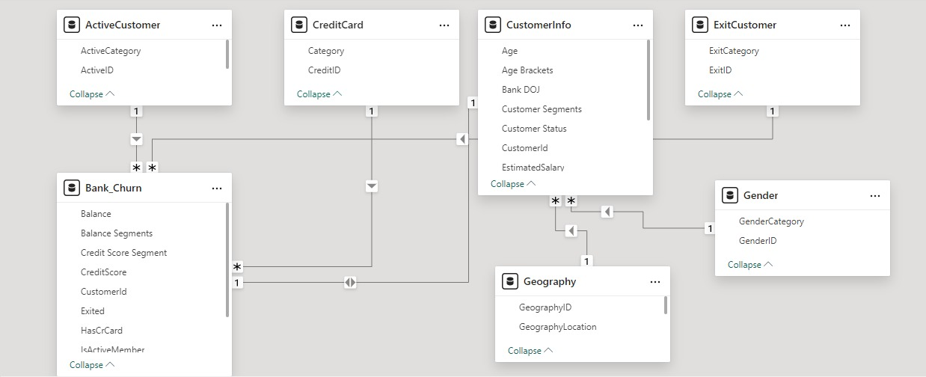
Database Schema

Slide 8
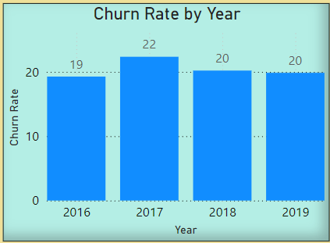
Objective & Subjective Analysis
INSIGHTS :
From 2016 to 2019, the average churn rate was 20%, which is not ideal since a lower churn rate is preferable. A high churn rate can suggest that customers are dissatisfied with the services or do not find them valuable.
RECOMMENDATION:
Improve Customer Service: Enhance the quality and responsiveness of customer support to increase satisfaction.
Launch Loyalty Programs: Offer rewards and incentives to encourage long-term customer retention.

Slide 9
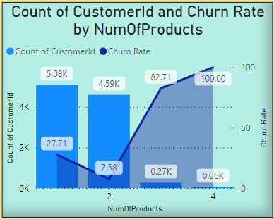
INSIGHT :
Customers who purchase no products have the highest churn rate at 100%, which steadily decreases as the number of products purchased increases. This indicates that customers who see value in the bank's products are more likely to remain loyal. Additionally, the majority of customers have purchased only one product, with the number of customers decreasing as they buy more products..
RECOMMENDATION:
Target New Customers: Focus on acquiring customers who haven't purchased any products by offering discounts or promotions to encourage their first purchase.
Upsell and Cross-Sell: Leverage the lower churn rates among customers with multiple products by recommending complementary products or services to those who have already made a purchase.

Slide 10
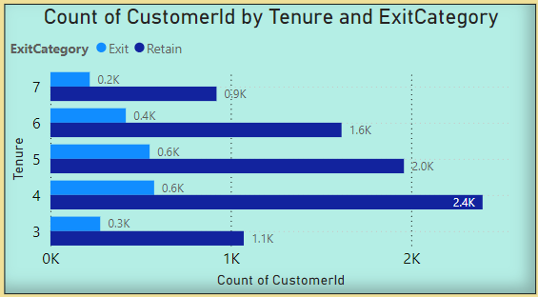
INSIGHTS:
Customers with tenure greater than 4 years show significantly higher retention rates. For example:
At 4 years of tenure, 2,396 customers are retained, while only 575 exit.
At 5 years of tenure, 1,960 customers are retained, with 550 exits.
Retention consistently remains high as tenure increases.
In contrast, customers with tenure of 3 years or less have a relatively higher churn rate:
At 3 years of tenure, only 1,072 customers are retained, while 276 exit.
RECOMMENDATION:
Develop personalized loyalty programs to reward customers for every year of continued service.
Offer tenure-based incentives, such as reduced fees or premium features, after the 4th year.
Educate customers on the advantages of remaining with the bank for an extended period, such as preferential rates on loans or exclusive offers

Slide 11
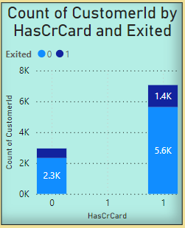
INSIGHTS:
Retention is Higher for Credit Card Owners
Customers with a credit card are nearly 10 times more likely to be retained compared to customers without one.
This indicates that credit card ownership is a strong factor in customer retention.
Exit Rates Are Higher Among Non-Cardholders:
Non-cardholders represent a disproportionate number of exits compared to their overall population.
RECOMMENDATION:
Offer incentives like lower fees, cashback rewards, or introductory benefits to customers who opt for a credit card.
Target campaigns specifically towards non-cardholders to educate them on the benefits of owning a credit card.

Slide 12
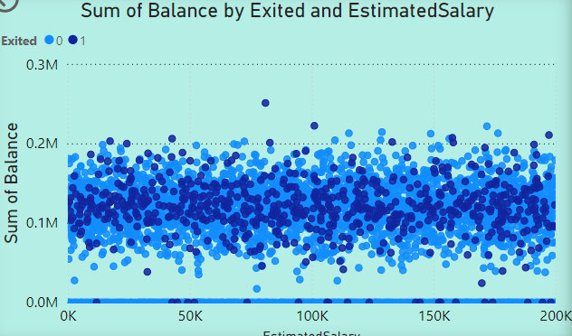
INSIGHTS :
Customers who exited tend to have a lower sum of estimated salary and balance compared to retained customers. However there are some outliers. There is a positive correlation between the sum of estimated salary and the sum of balance. This means that customers with a higher estimated salary also tend to have a higher balance.
RECOMMENDATION :
Provide personalized offers, such as fee waivers, loyalty rewards, or small credit boosts, to encourage engagement.
Conduct a deeper investigation into the outliers who churned despite high balance or salary.
Focus marketing efforts on customers with higher estimated salaries, as they also tend to have higher balances.

Slide 13
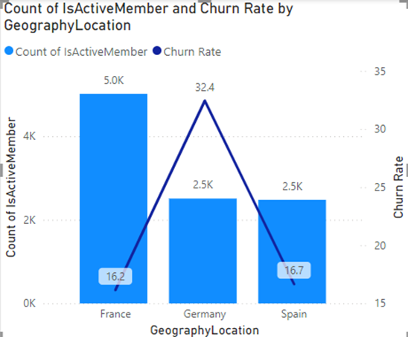
INSIGHTS :
France: Highest active members (5.0K) and low churn rate (16.2%). Strong retention.
Germany: High churn rate (32.4%) despite fewer active members (2.5K). Retention challenges.
Spain: Same active members as Germany (2.5K) but lower churn rate (16.7%). Stable retention.
RECOMMENDATION :
Germany:
Investigate churn reasons via customer feedback.
Enhance customer experience and offer incentives to retain customers.
France:
Maintain strong retention with proactive churn monitoring.
Leverage growth through referral campaigns and upselling.
Spain:
Expand the customer base with promotional campaigns.
Fine-tune retention strategies to match France's performance.
General:
Replicate France’s best practices in other regions.
Localize services and monitor churn KPIs for all geographies.

Slide 14
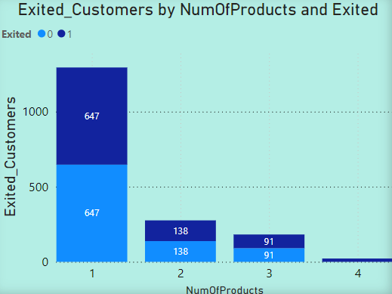
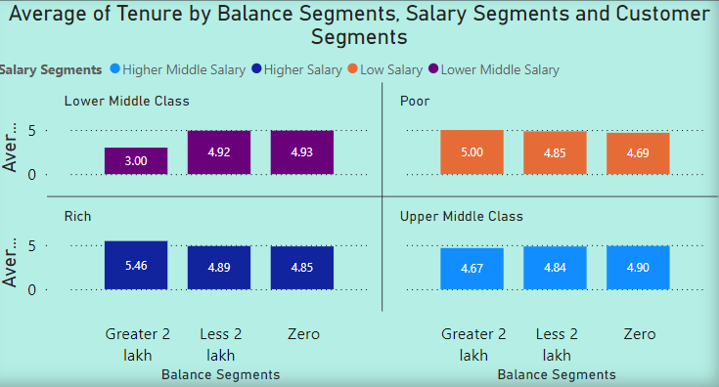
INSIGHTS :
Customers with more products may have higher satisfaction but could also feel overwhelmed, leading to frustration in some cases.
RECOMMENDATIONS :
Analyze NumOfProducts alongside other factors like customer satisfaction and service quality. Provide tailored account management to simplify multi-product handling and improve retention.
INSIGHTS :
Customers with higher balances, especially those earning high salaries and with balances above 2L, have the longest tenure (5.4 years). Zero-balance customers have the shortest tenure (4.2 years).
RECOMMENDATIONS :
Offer exclusive benefits to high-balance customers to maintain loyalty. Provide incentives like fee waivers or savings plans to engage and retain zero-balance customers.

Slide 15
ANALYSIS AND KEY INSIGHTS
The poorest credit score segment (300-579) experiences the highest exit rate.
Possessing a credit card does not significantly affect churn rates.
The most common number of products among customers who have exited the bank is one.
A large number of customers join the bank during the months of august to december.
Individuals aged 30-50 hold the most credit cards.
The highest churn rate and the lowest number of active members indicate that germany is a significant financial risk for the bank

Slide 16
ANALYSIS AND KEY INSIGHTS
The poorest credit score segment (300-579) experiences the highest exit rate.
Possessing a credit card does not significantly affect churn rates.
The most common number of products among customers who have exited the bank is one.
A large number of customers join the bank during the months of august to december.
Individuals aged 30-50 hold the most credit cards.
The highest churn rate and the lowest number of active members indicate that germany is a significant financial risk for the bank

Slide 17
Strategies to Decrease Churn Rate
Offer Incentives on multiple product combos to attract single product customers.
Create new schemes for the customers to increase Tenure.
Improve customer engagement and enhance customer service.
Improve the products by taking feedback from the customers.
To increase profitability and decrease loan defaulters provide loans to the customers who have high credit score only.
Incentivize the customers who join the bank in Quarter 1 to increase customer base in the quarter.

Slide 18
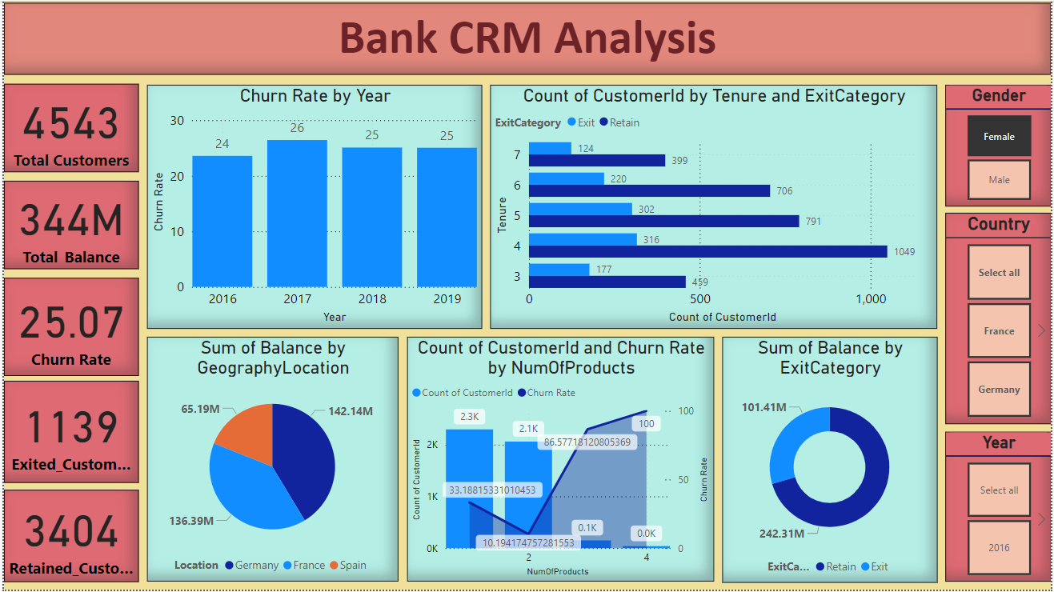
Dashboard

Slide 19
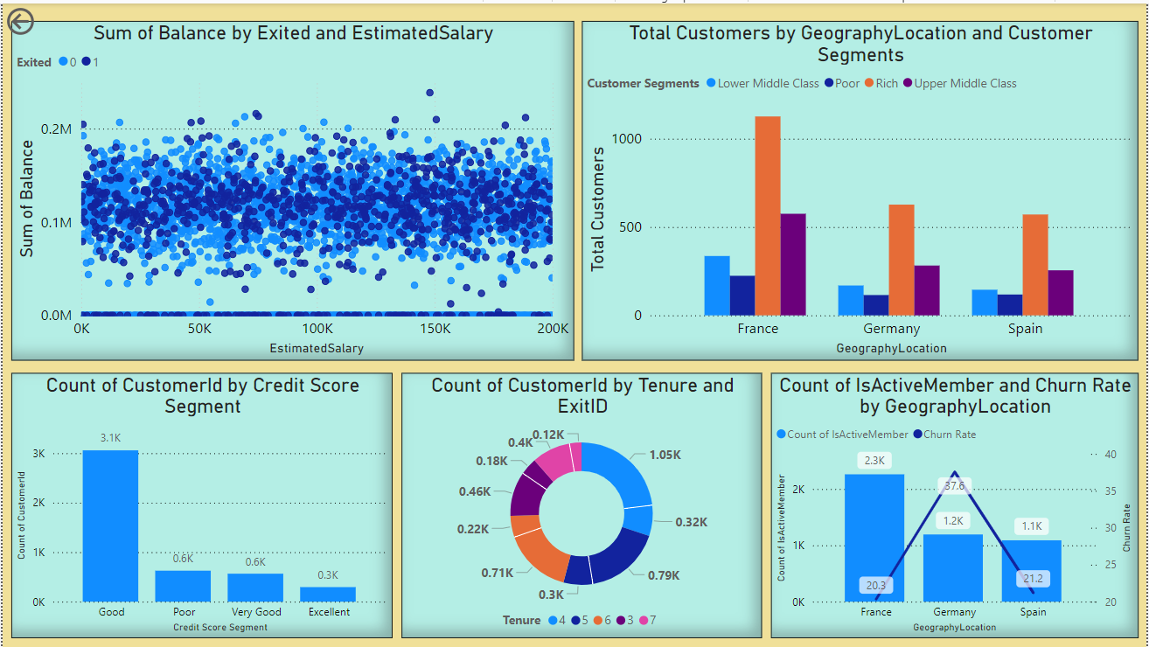

Slide 20
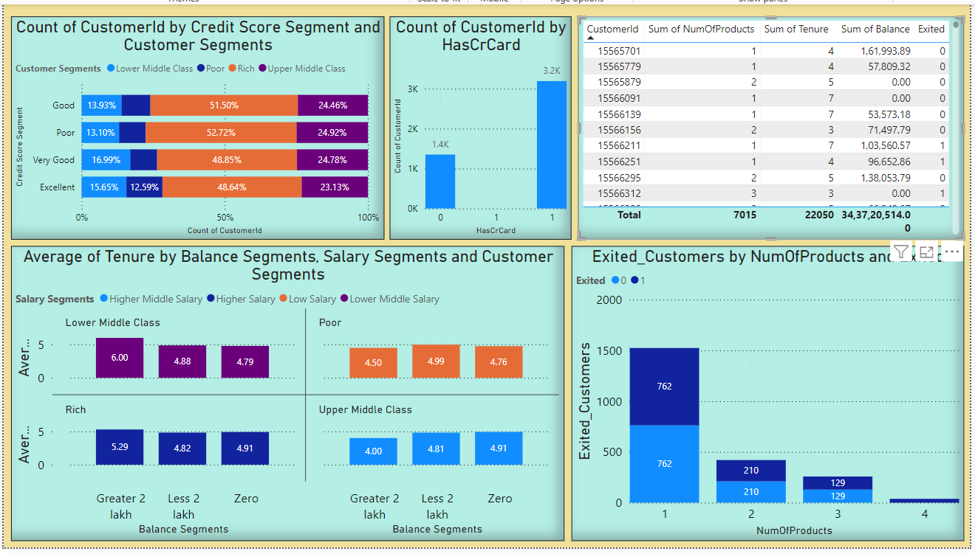

Slide 21
CONCLUSION
The bank has faced a consistent churn rate despite a steady increase in new customers.
Customers with lower credit scores and those using fewer bank products are more likely to churn.
Older and middle-aged groups have the highest churn rates, posing unique retention challenges.
Boosting customer engagement and enhancing customer service are crucial to reducing churn.
Offering competitive products and services can help attract and retain customers.
Targeted marketing and personalized offers can retain key segments based on age and credit score.

